Slide 1


Notes:
Team intro: names
Our theme: post-secondary CS education

Slide 2
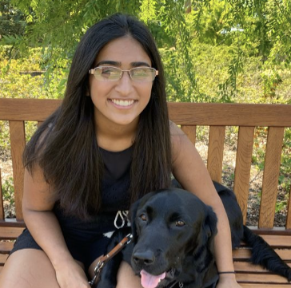



The CoCode Team
Trisha K.
Daniel R.
Juliette W.
Angela C.

Slide 3
Mission Statement: Cocode exists to provide a welcoming and collaborative space that empowers students in postsecondary CS classes to learn and share their knowledge with their peers.

Slide 4

Suggested UI Changes From A5
Specify and add features to whiteboard space: chat, coding environment, personal work space, etc.
Provide resources from lectures or textbooks for students to browse before they seek help
Make signing up to teach a problem more intuitive
Collaboration vs. teaching functions: how do they overlap and differentiated
Reorder the tabs on the top of each page
save/upload the progress on the whiteboard
Show the progress of each discussion room
My stuff dashboard/portfolio

Slide 5
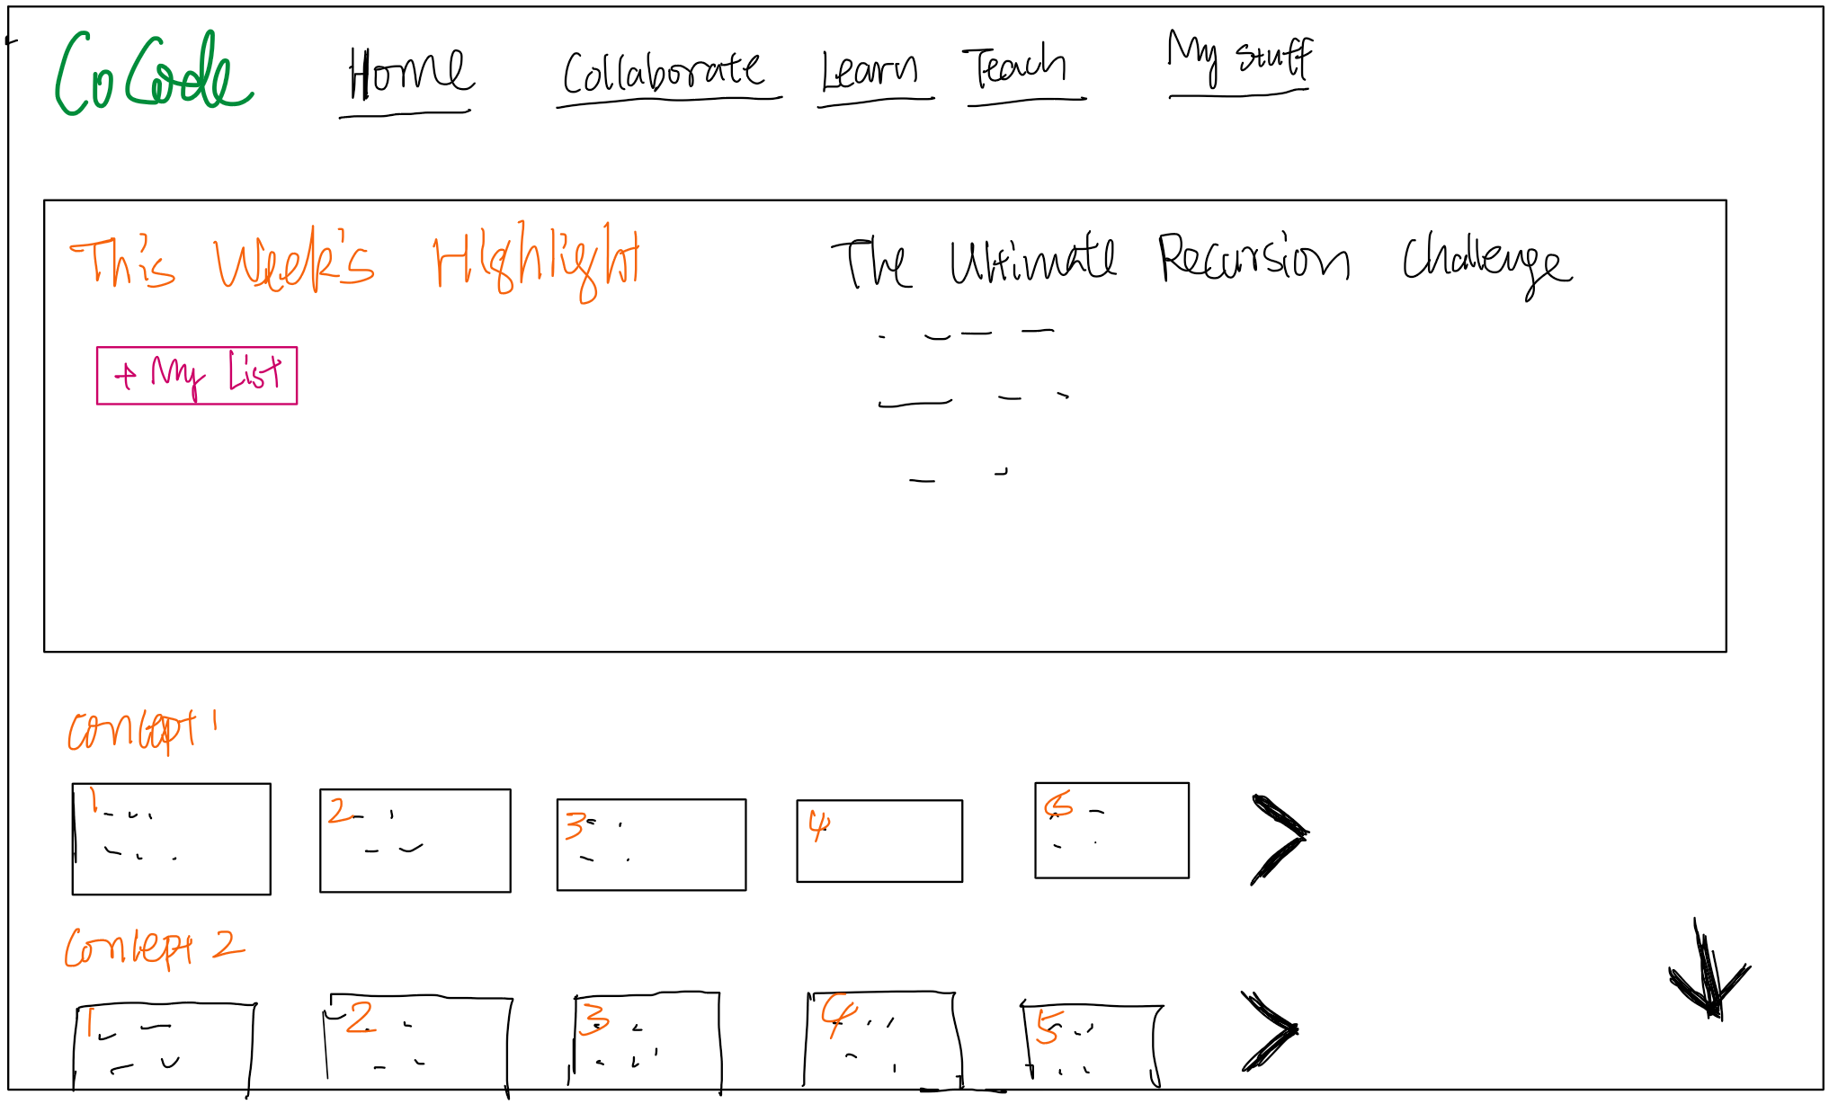
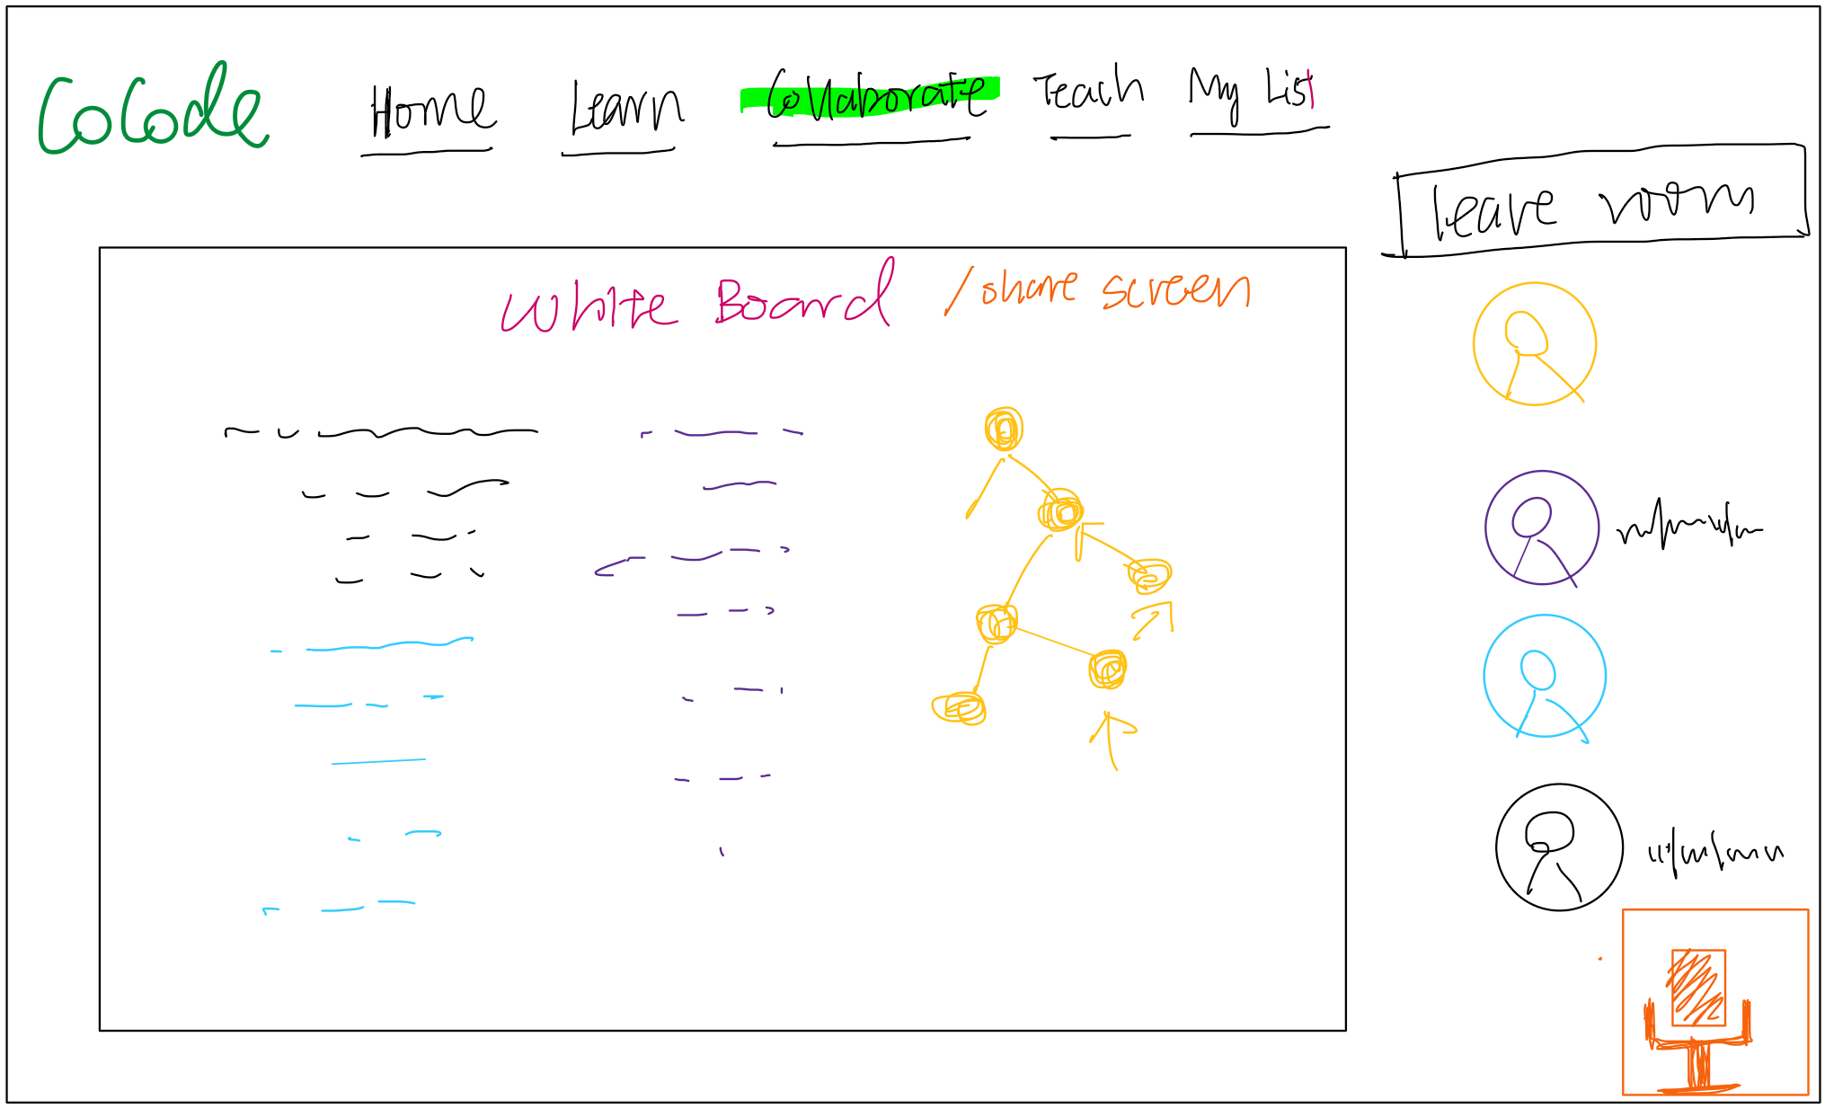
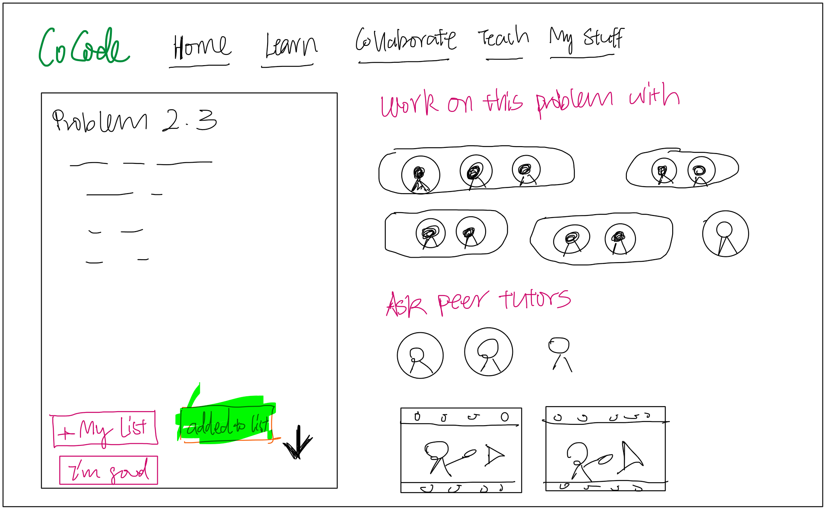
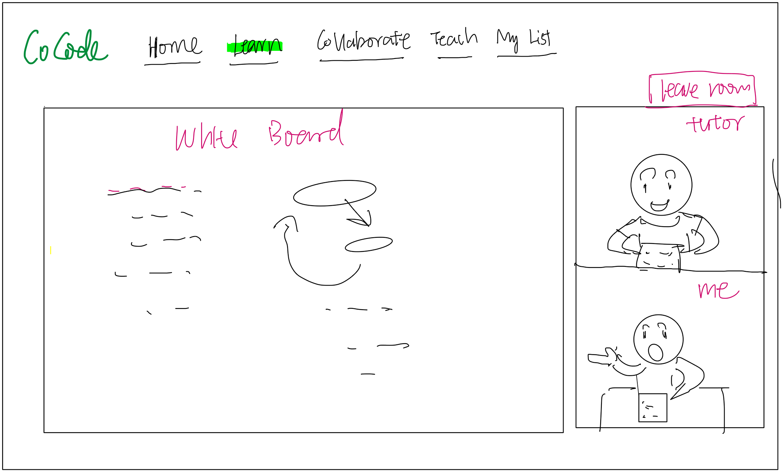
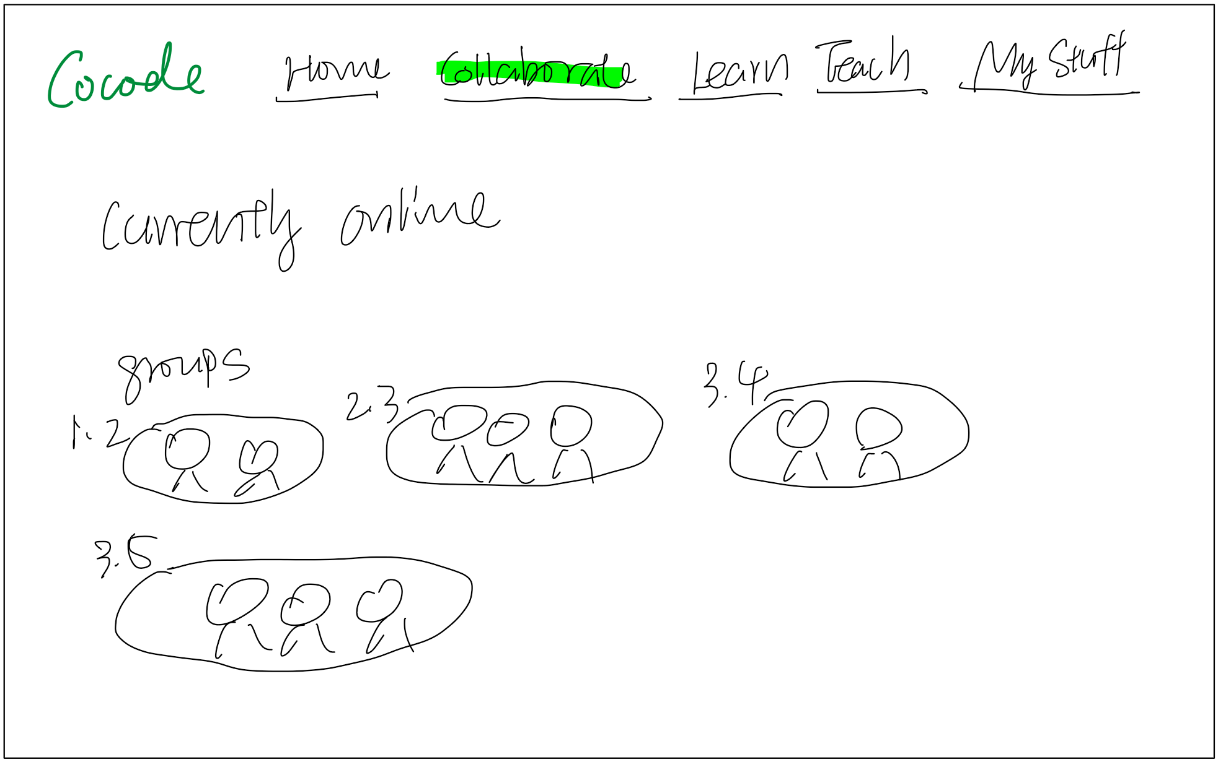
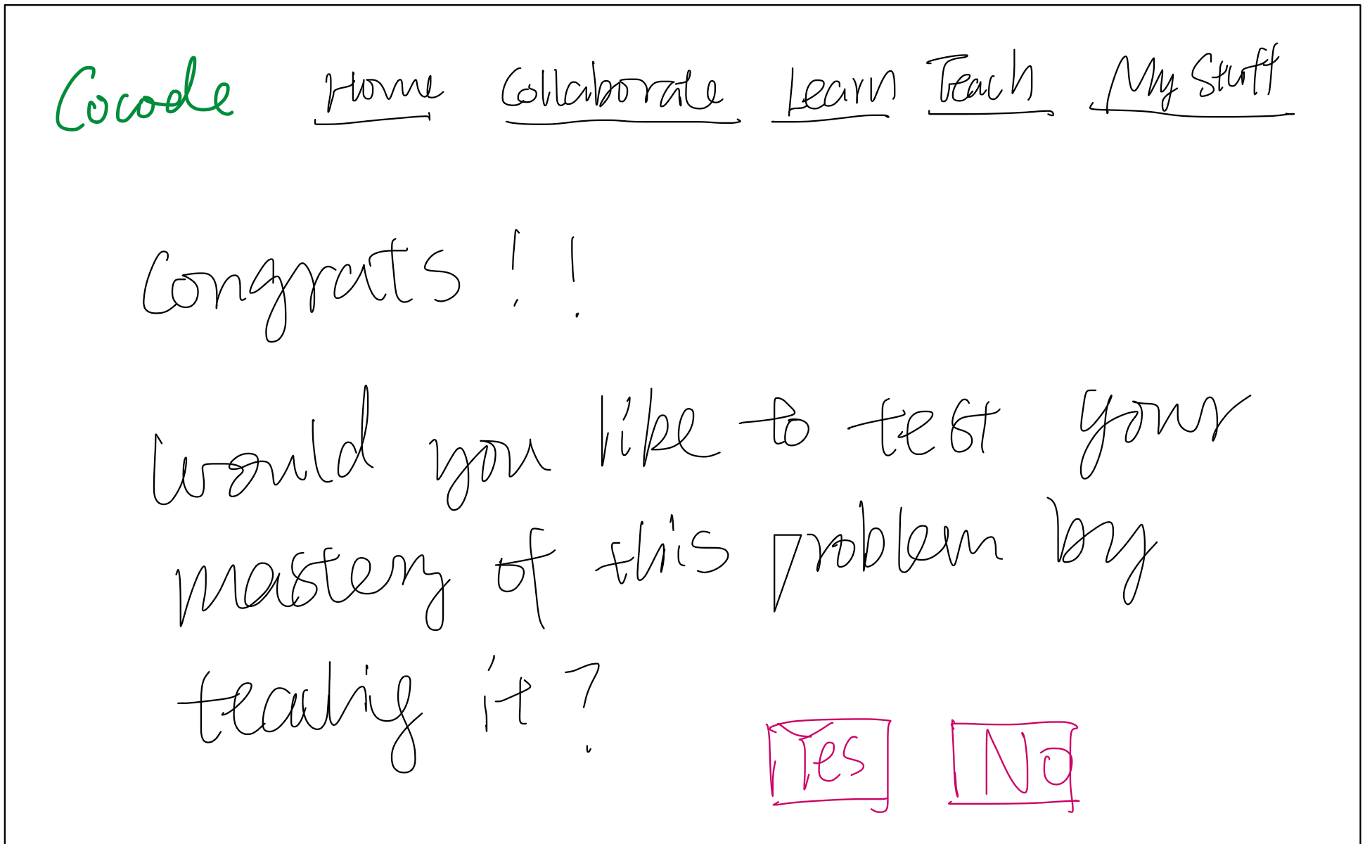
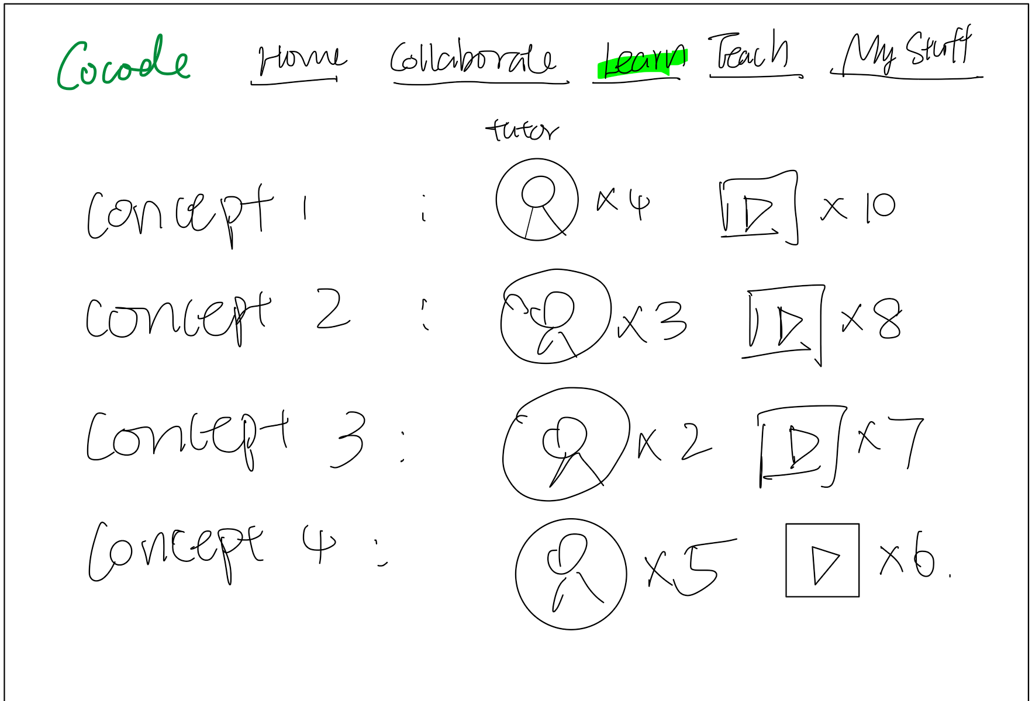
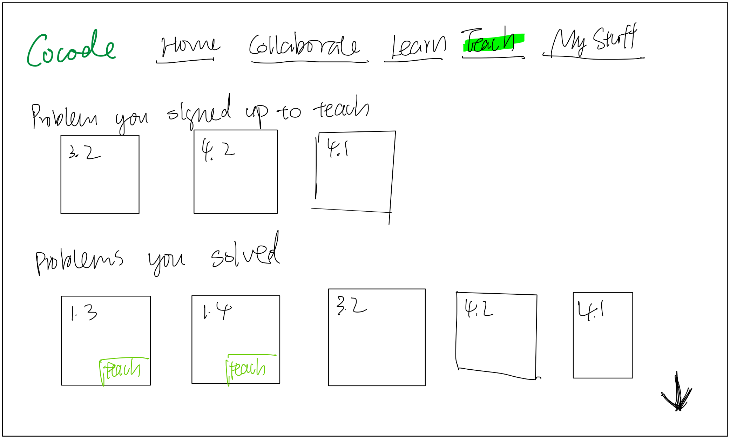
Recap: Prototype Structure
Home
Collaborate on a problem
Problem
Learn/teach a problem
Collaborate tab
Prompt to teach
Learn tab
Teach tab

Slide 6

Task 1: Learn from Peers
“You are taking an introductory computer science class on data structures. It is later in the evening, and you weren’t able to make it to lecture or office hours earlier in the day, which has resulted in you being very stuck getting started on problem four.You go onto this platform seeking a conceptual explanation on breath for search algorithms. Where do you go?”

Slide 7
Task 1: Learn from Peers
Changes We Made:
Offer students the option to review course material
  Lectures, Section Handouts, Assignments
The ability to sign up for problems that you want to learn
  Can be notified when a peer teacher is available for a given problem
Updated the whiteboard to be a more collaborative space with options for both coding as well as a white board side-by-side. Users can also share screen. When finished working, students can save what they have created on the collaborative space.

Slide 8
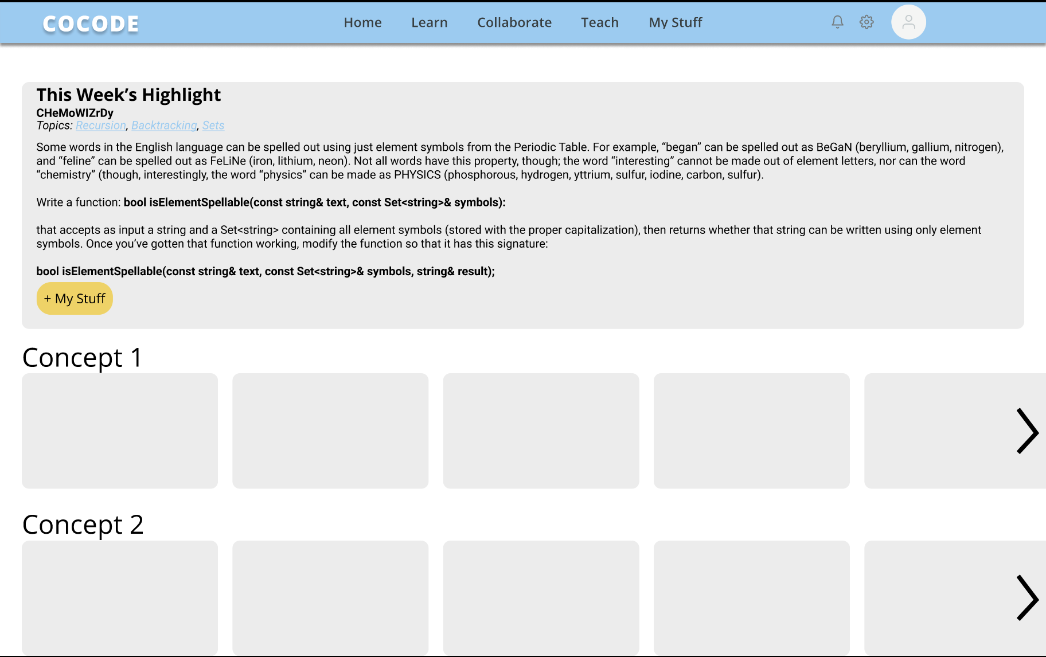
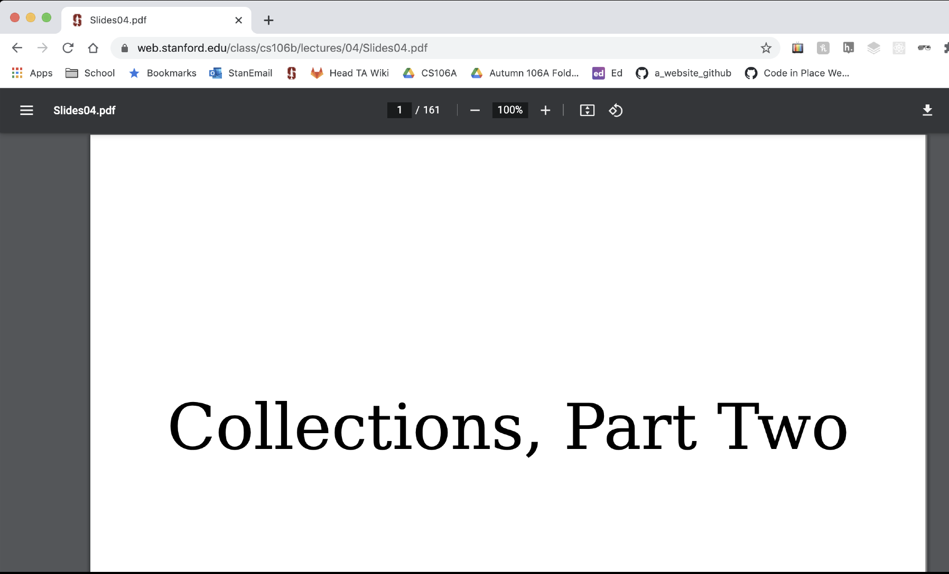
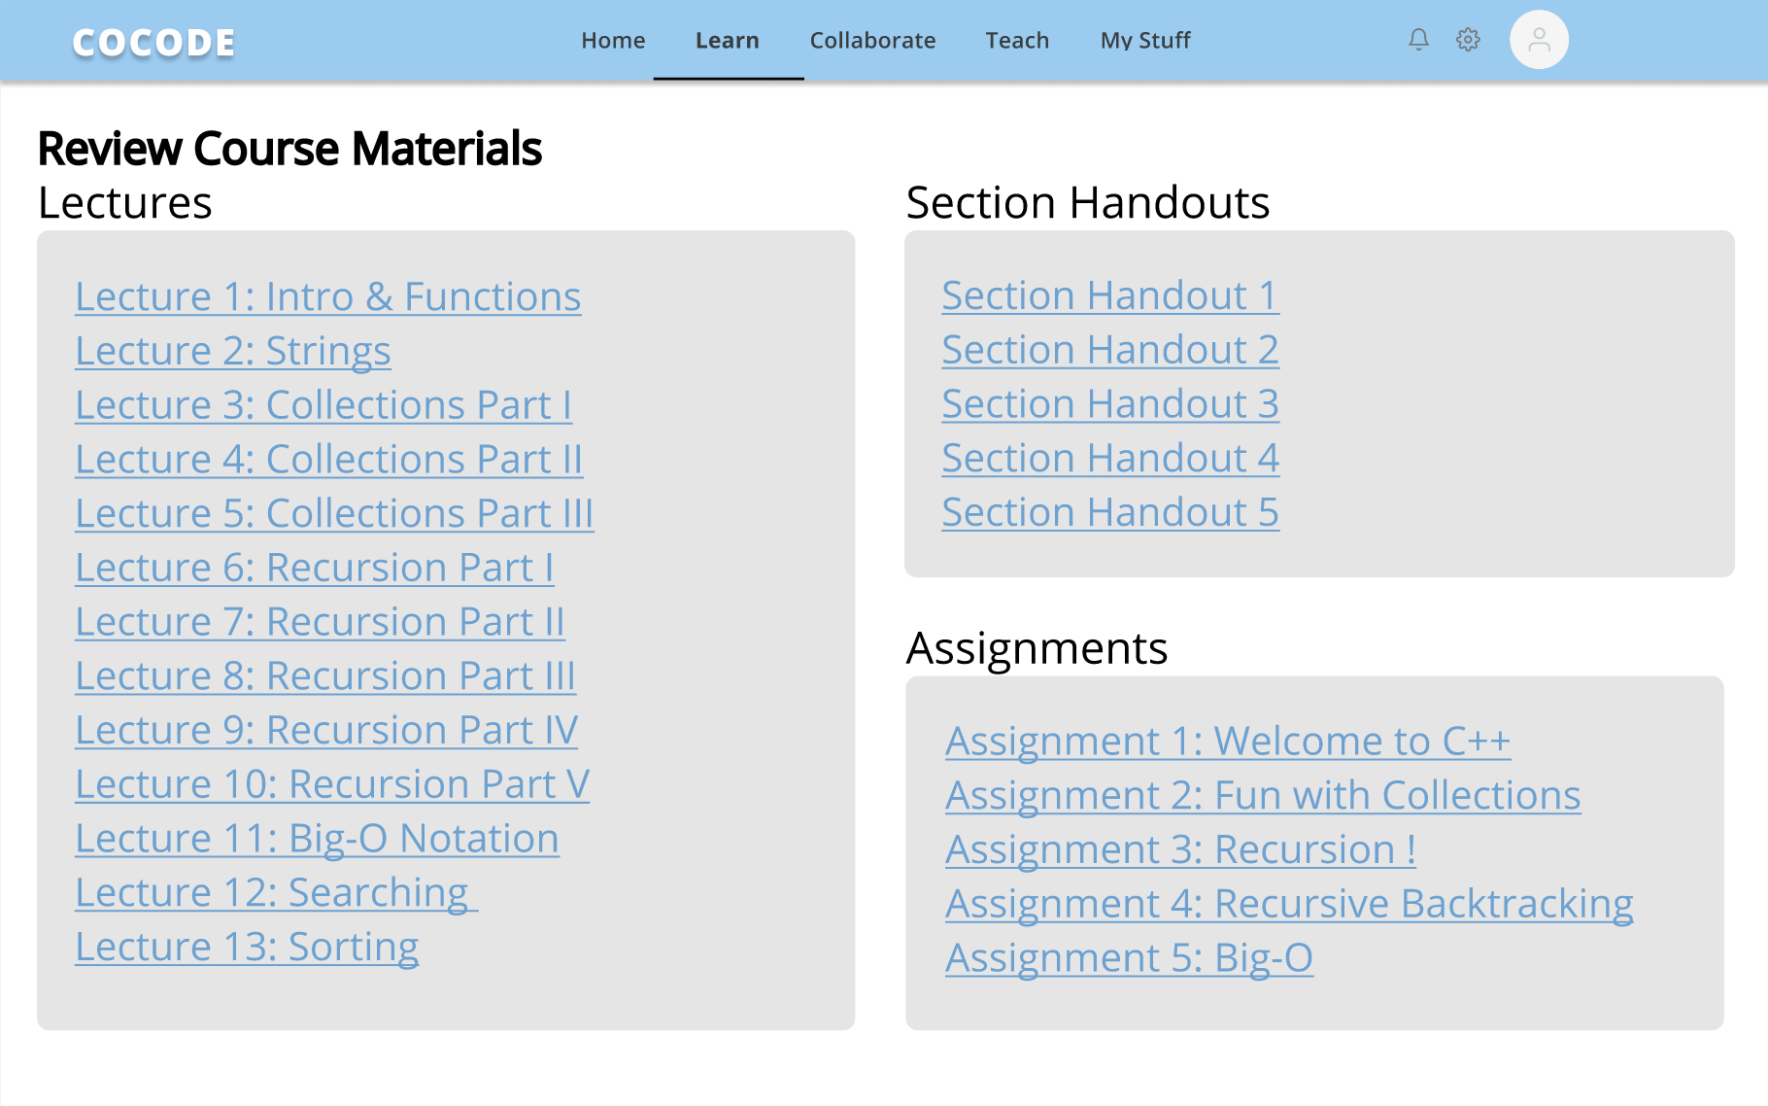
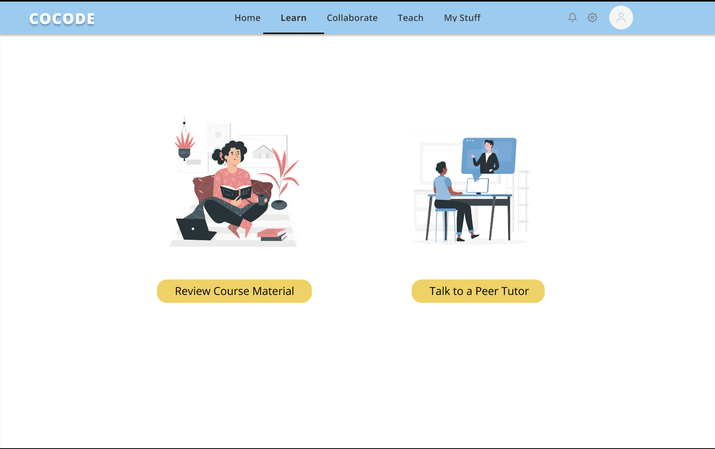
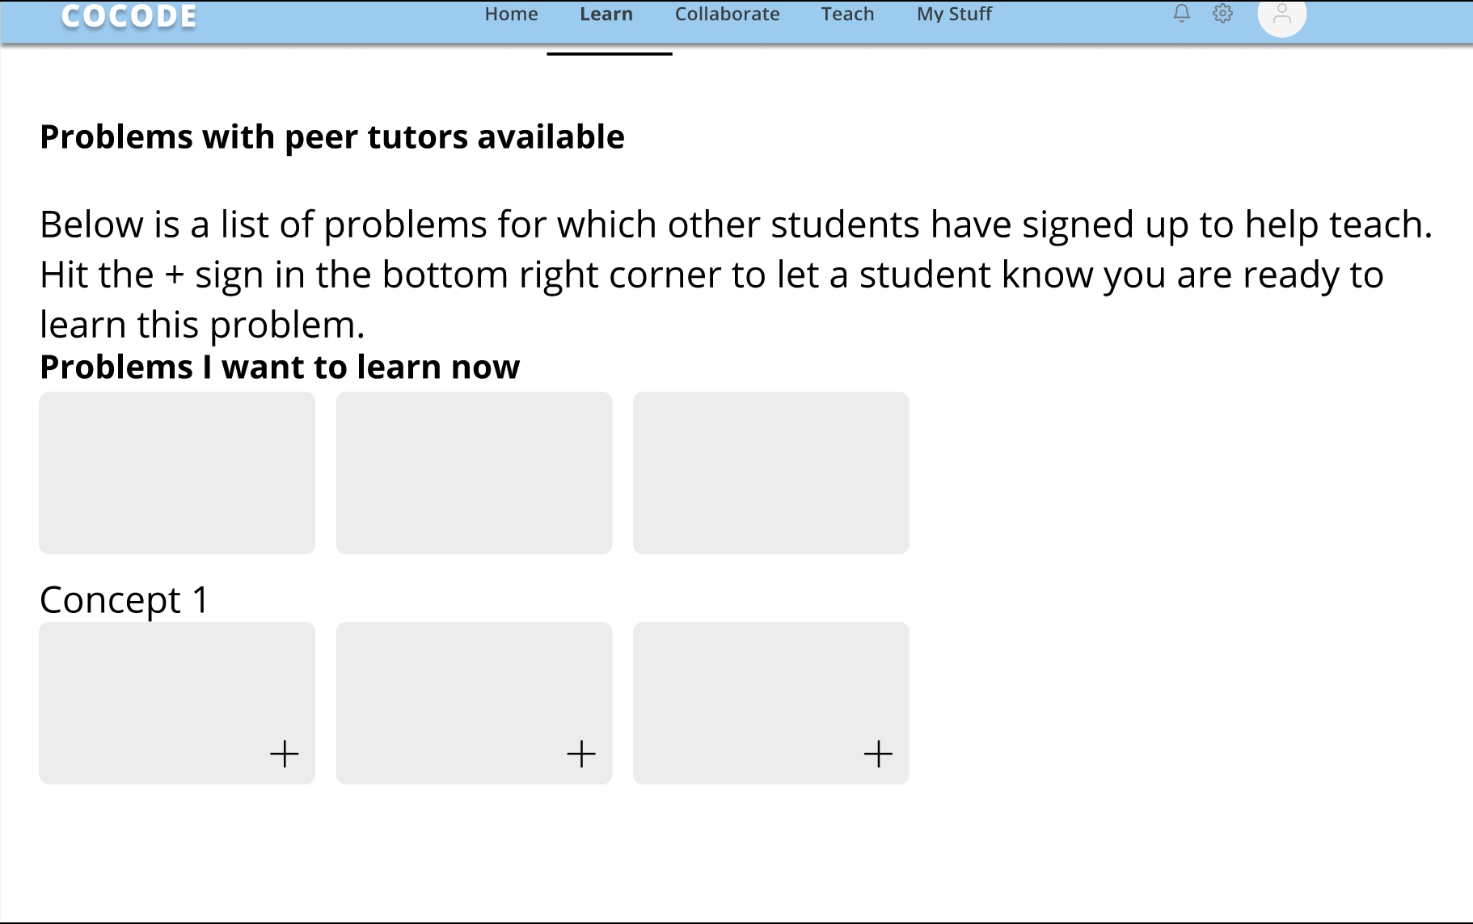
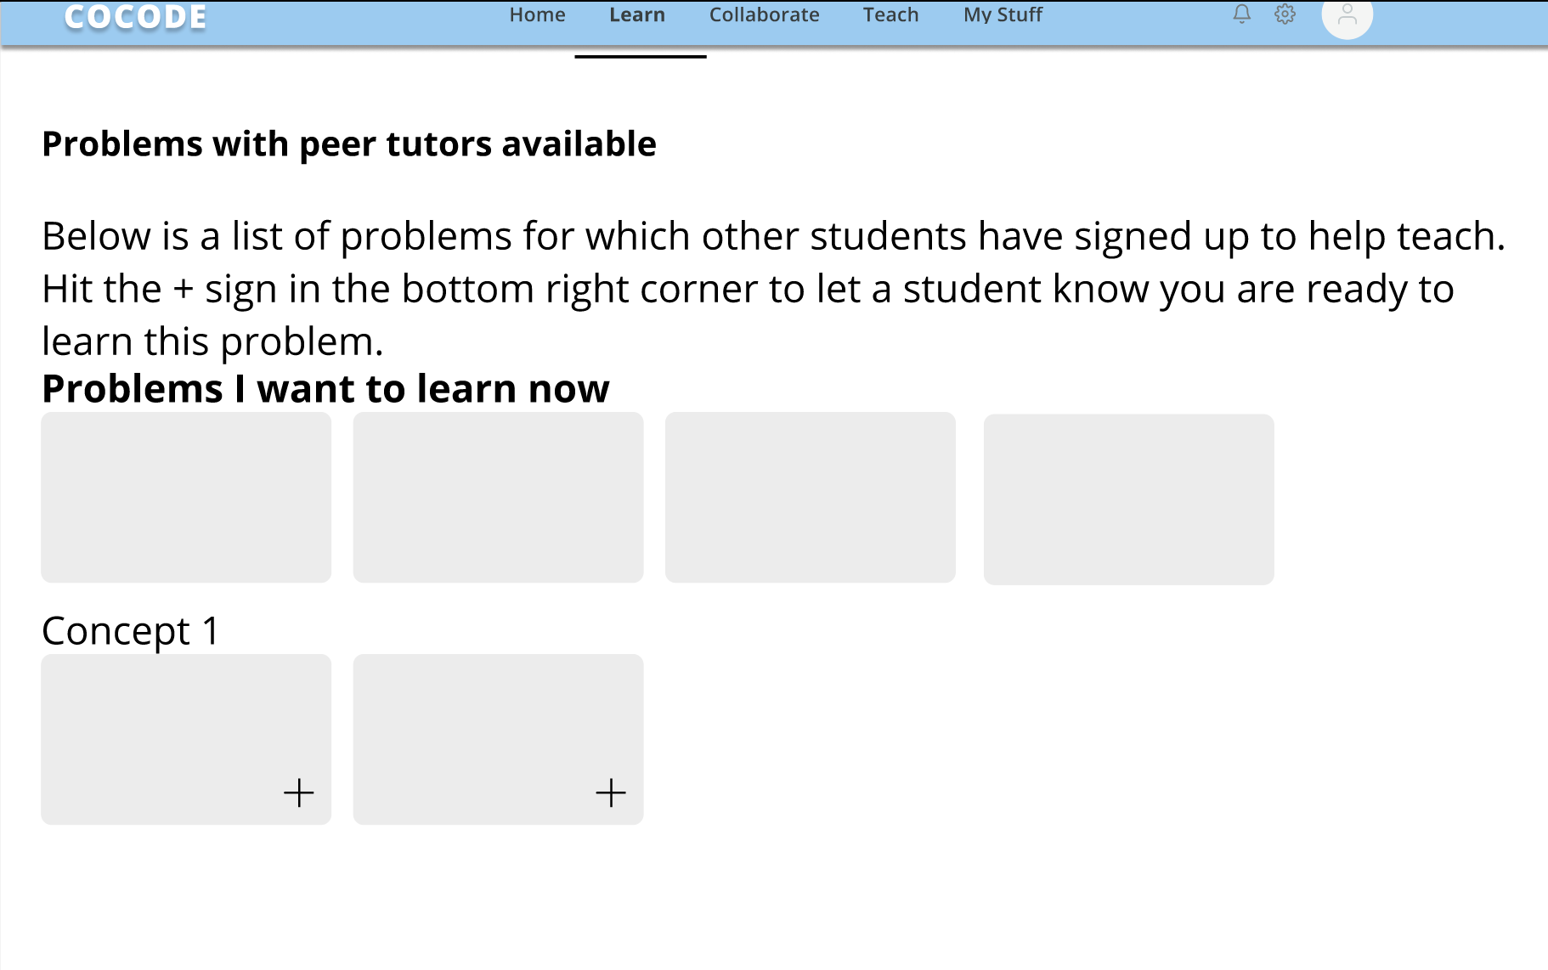
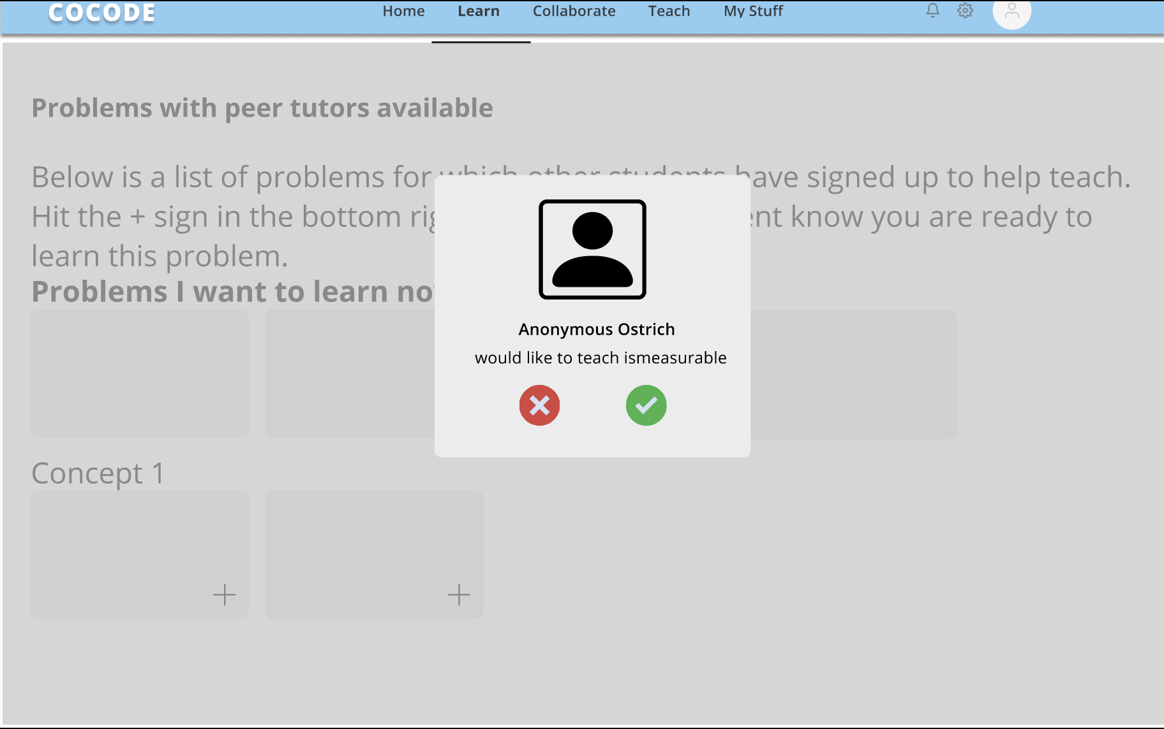
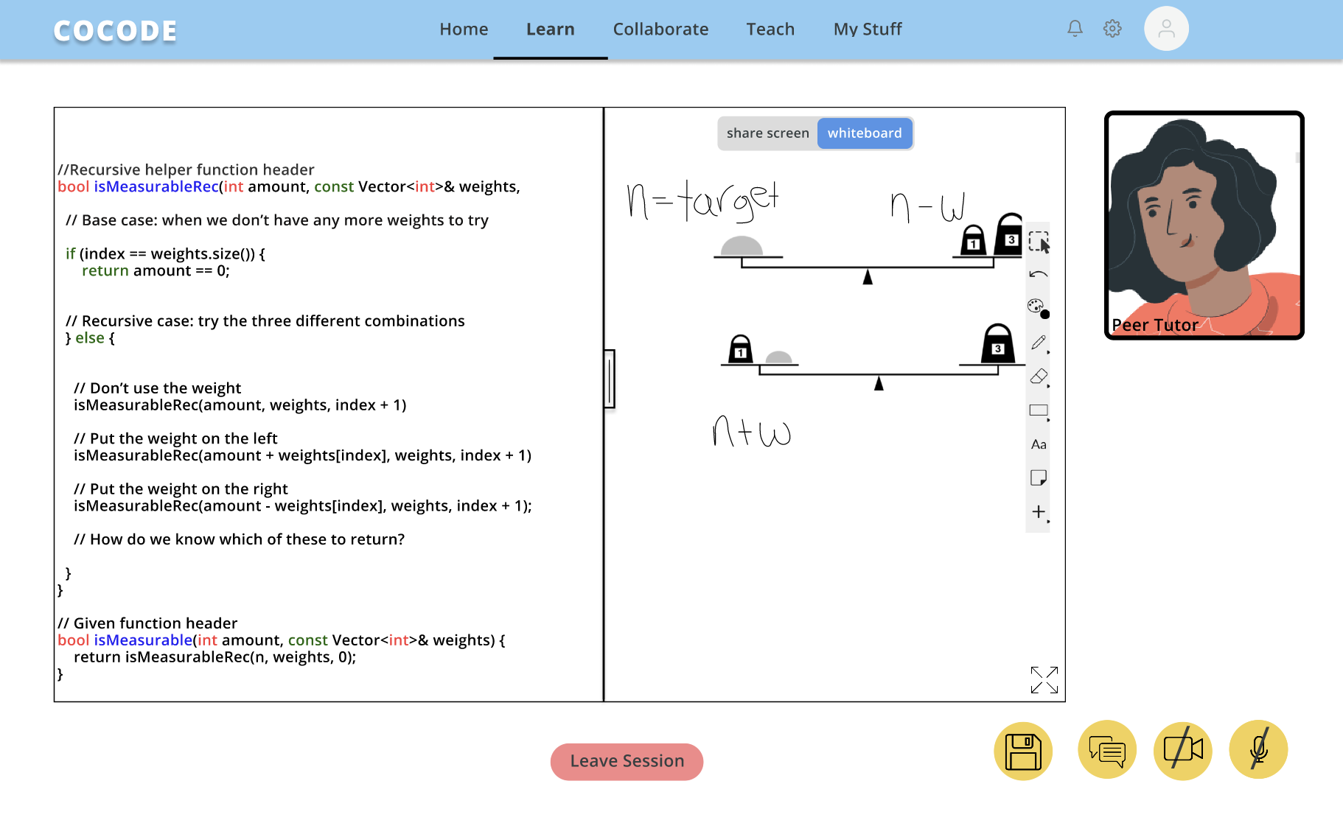
Task 1: Learn from Peers

Slide 9

Task 2: Collaborate
“You are preparing for a final exam worth a big portion of your grade, and you go onto our platform seeking discussion and practice with concepts. There are a few clarifications you want to receive about a data structure used in problem four, but you also feel like you have some understanding to share. Where do you go?”

Slide 10
Task 2: Collaborate
Changes We Made:
This task flow stayed mostly consistent with last week’s low-fi prototype.
One change we made was offering the option to review lecture material related to a given problem from the problem page
We also changed the flow of the main collaborate page. Rather than showing all possible problems, there is a drop-down at the top to move between different concepts

Slide 11
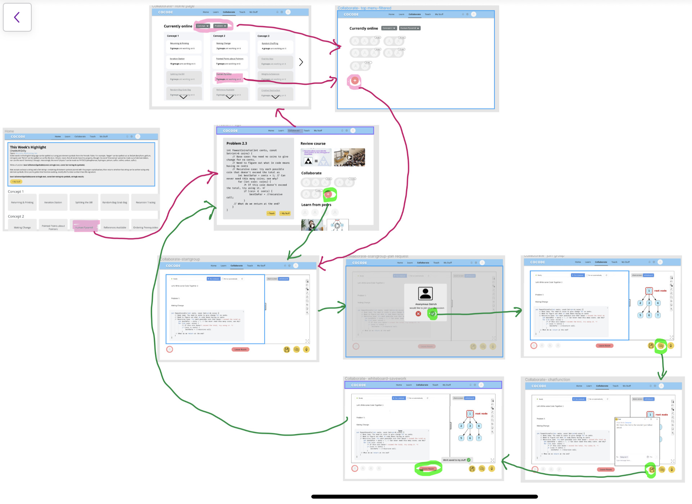
Task 2: Collaborate

Slide 12

Task 3: Teach a Problem
“After studying for your exam for many hours and succeeding in practicing problem 4 on our platform, you feel much stronger about your understanding of a tough concept. You decide you want to test your mastery and share how you came to think about the problem with others. What do you do?”

Slide 13
Task 3: Teach a Problem
Changes We Made:
Flow for signing up to teach
  Now you can sign up for problems that you are excited to teach and be notified when there is a student who wants to learn that topic
  Once this notification arises, one can join on a call right then, message them, or decline
If you do not want to teach live, we provided the option to record using CoCode software and whiteboard space rather than your own computer software.

Slide 14
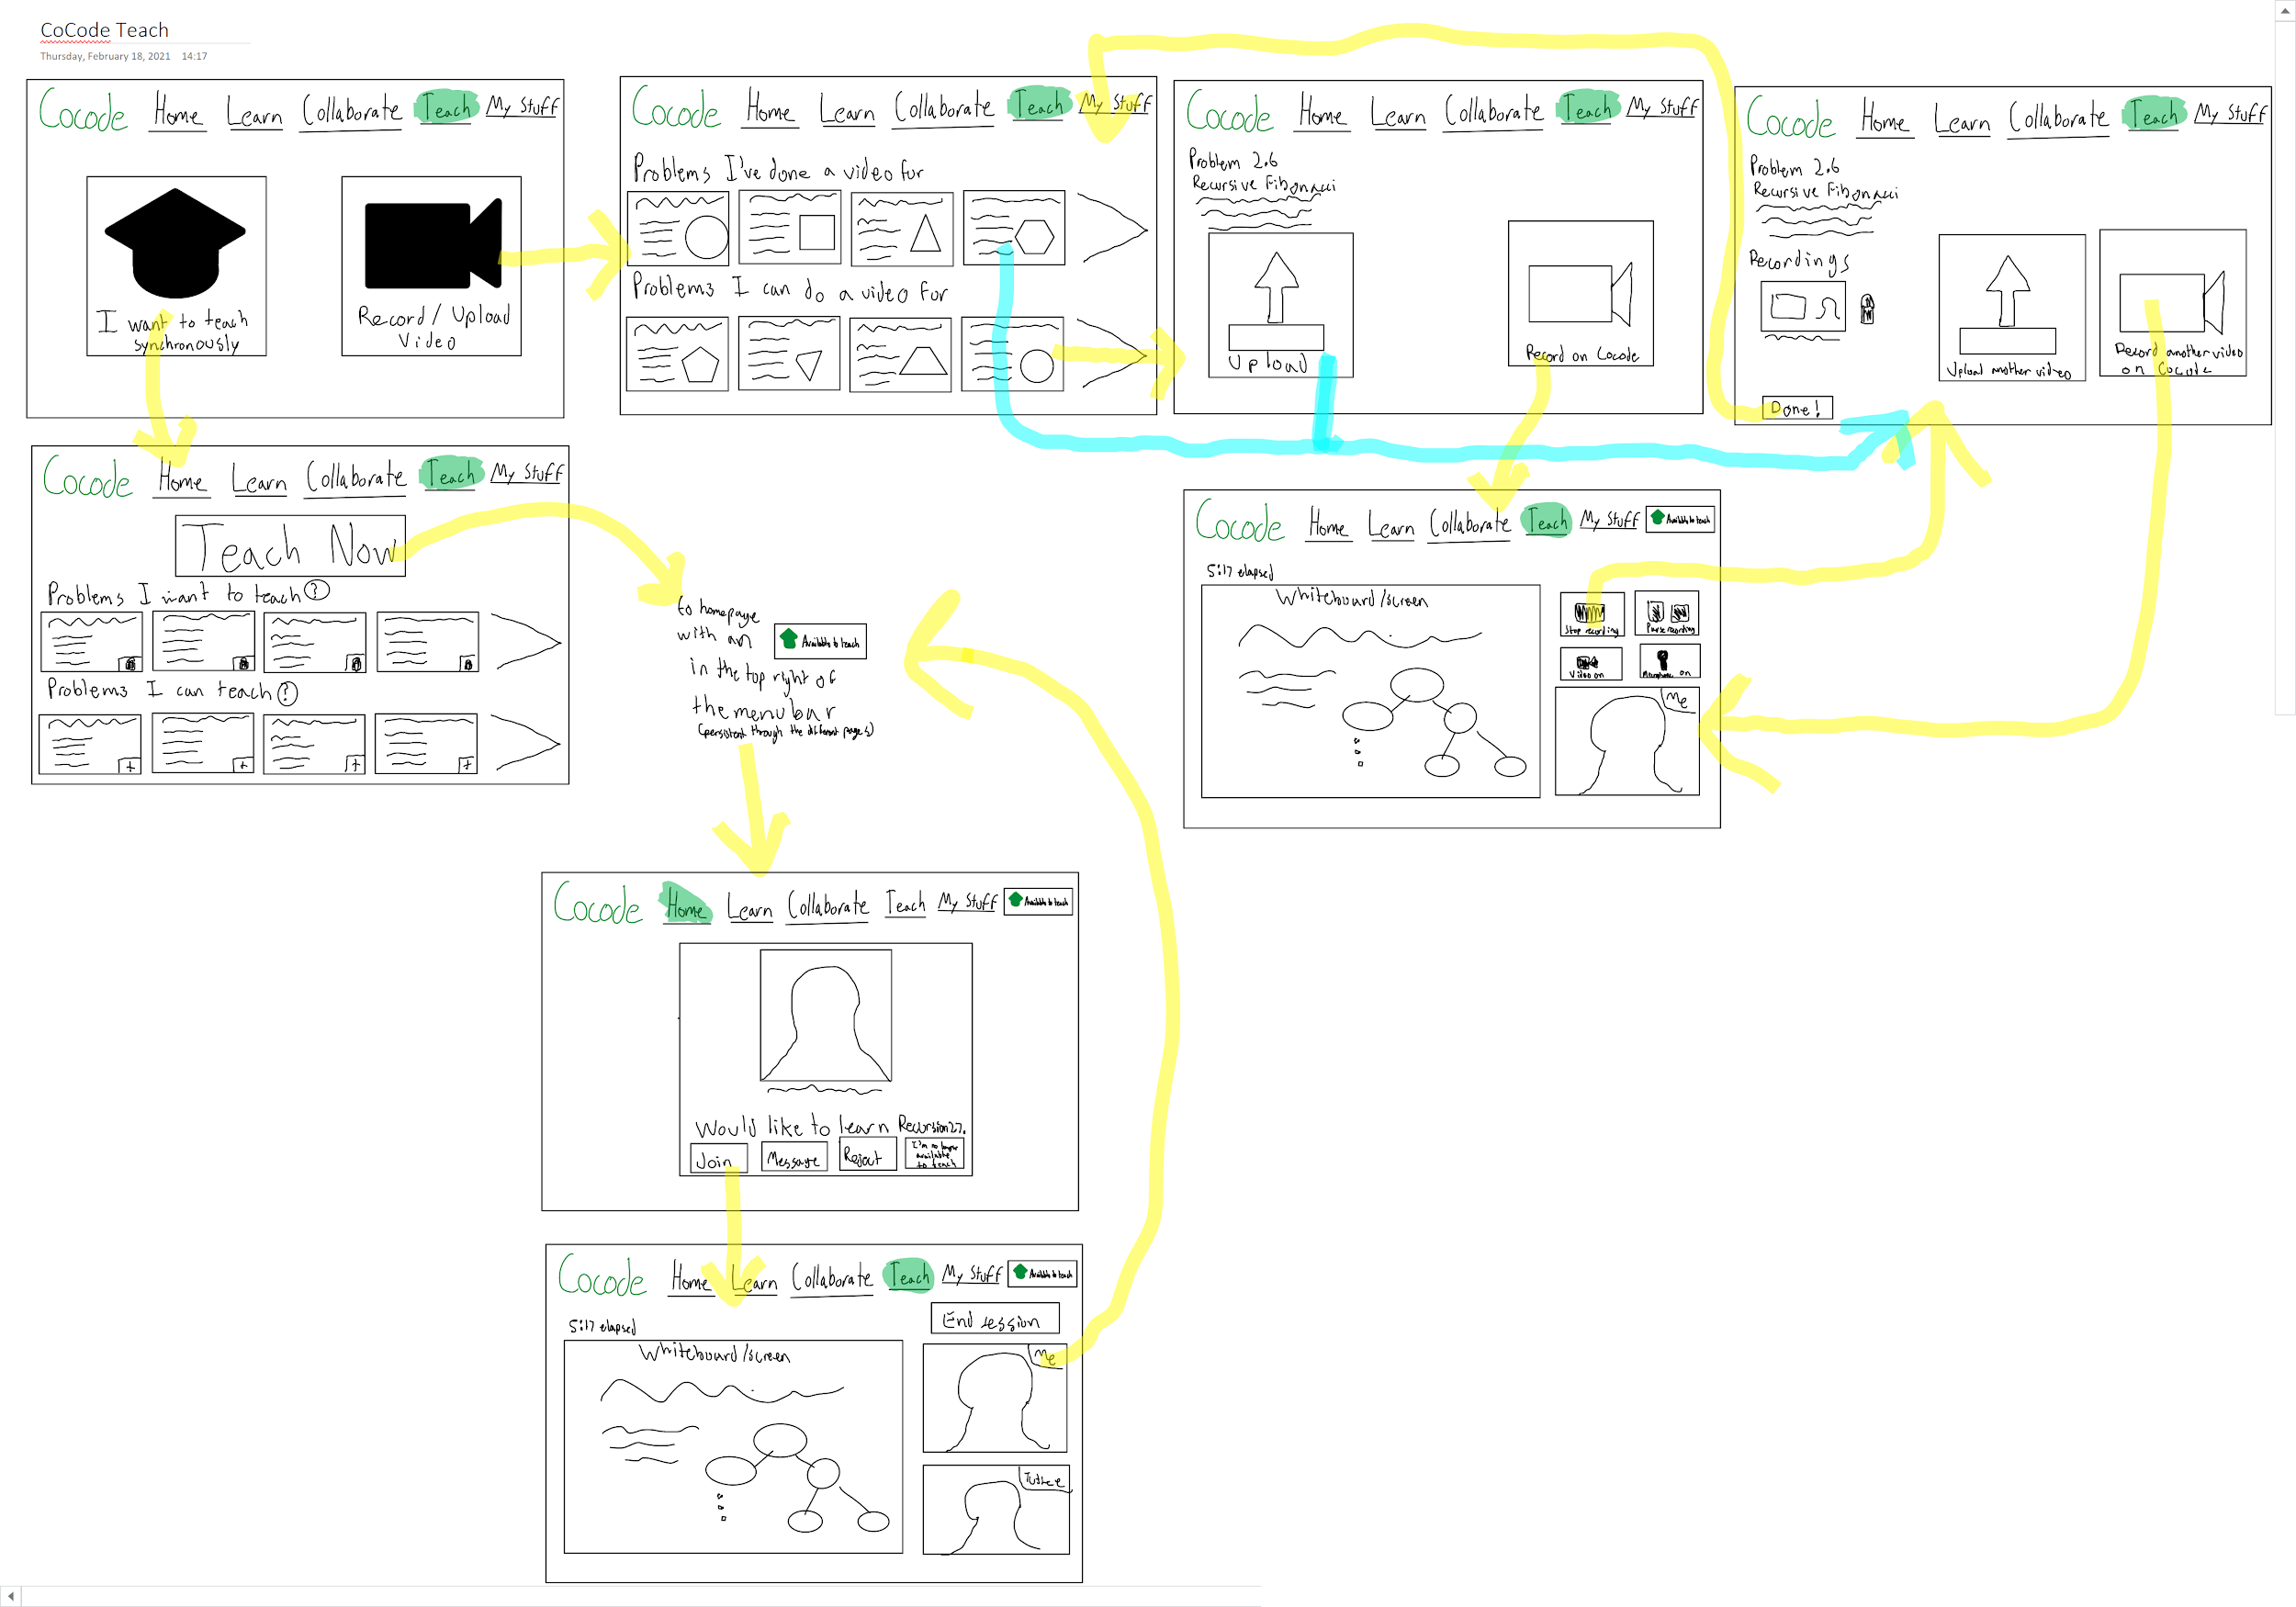
Task 3: Teach a Problem

Slide 15
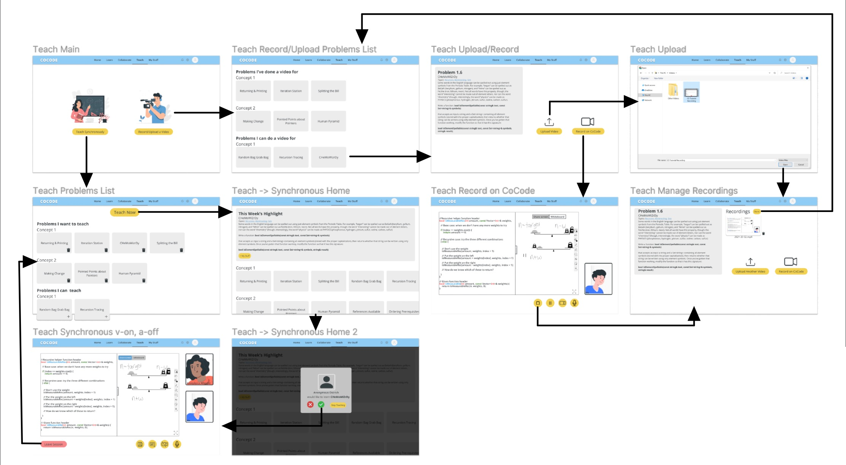
Task 3: Teach a Problem

Slide 16
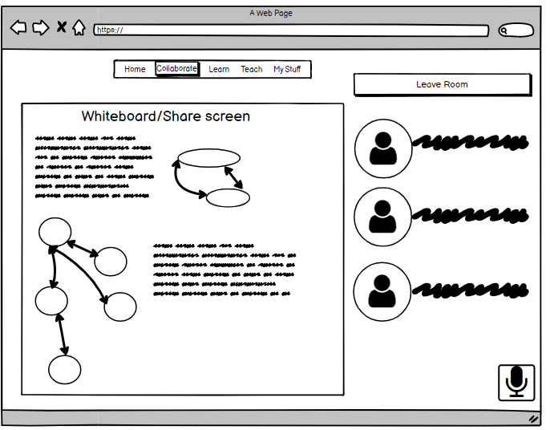
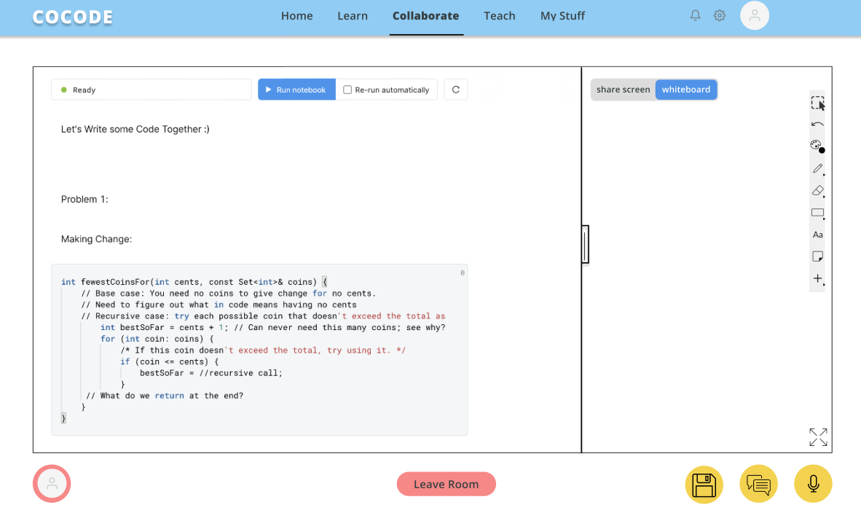
Revised: Whiteboard
Before
After

Slide 17
Revised: Whiteboard
Switch between whiteboard & share screen
Before
After
Unspecified whiteboard functions
Collaborative coding space
Whiteboard space
Participants take up much space
Moveable border
Simple audio setting
Save progress, chat, audio adjustment buttons

Slide 18
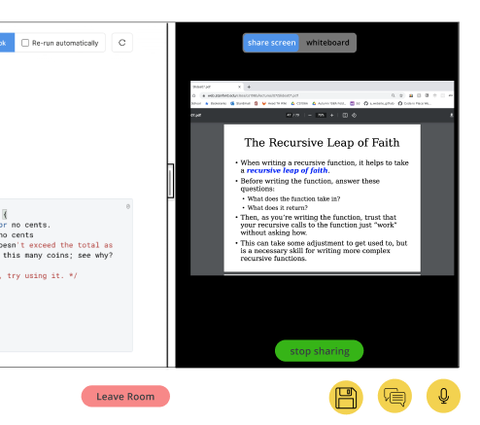
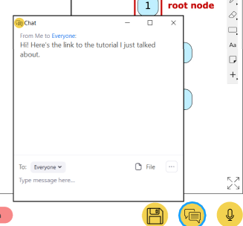
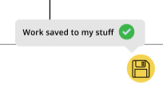
Revised: Whiteboard
Switch to share screen: one-click fast demo
Chat: file/link/chat exchange
Save work: seamlessly fit in the assignment workflow

Slide 19
Revised: Whiteboard
Rationale:
The additional features were requested by all of our testers. Enabling side-by-side code editing and whiteboarding/screen sharing capabilities is essential to providing a high quality collaboration experience, which is the core of our product.

Slide 20
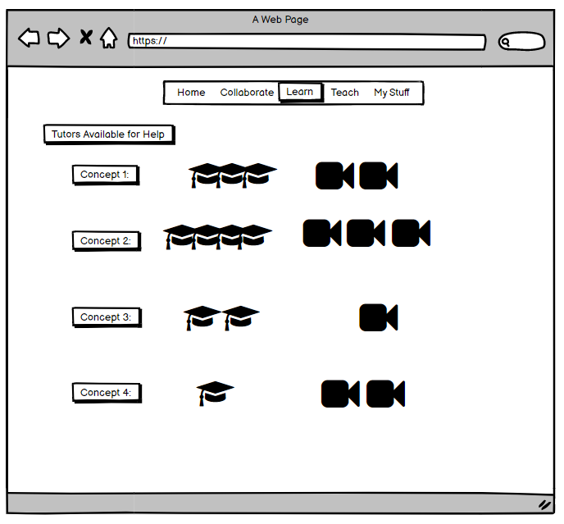
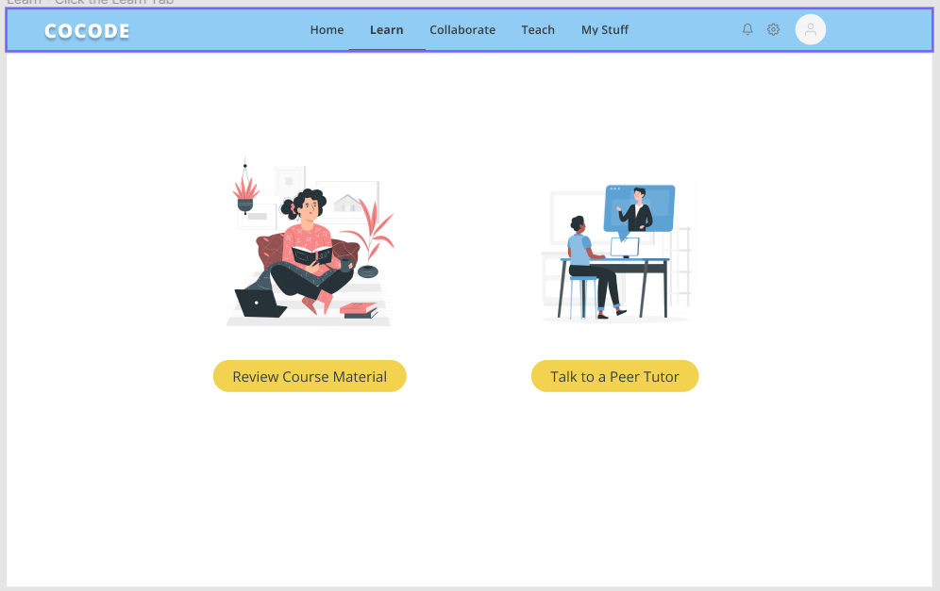
Revised: Course Material Review
Before
After
Peer tutor is the only option
Can review course material before getting help

Slide 21
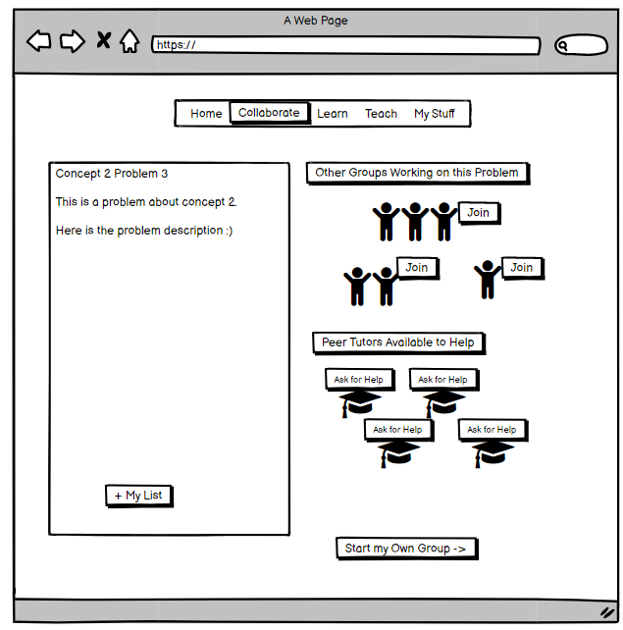
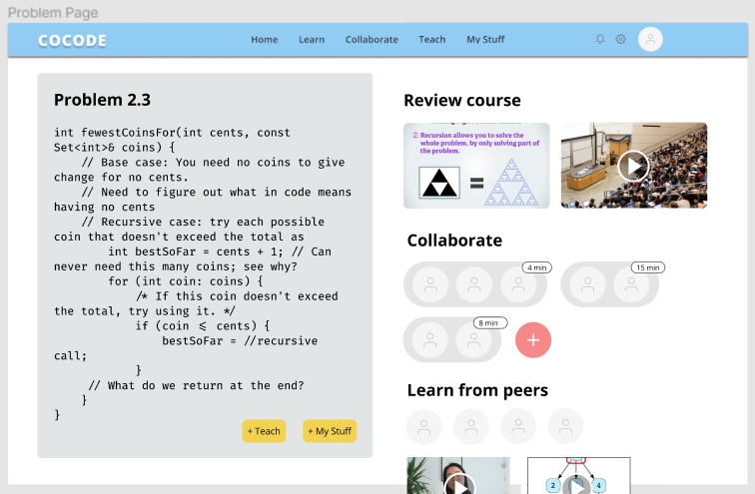
Revised: Course Material Review
Before
After
Collaborate or learn from peers
Can review corresponding course material

Slide 22
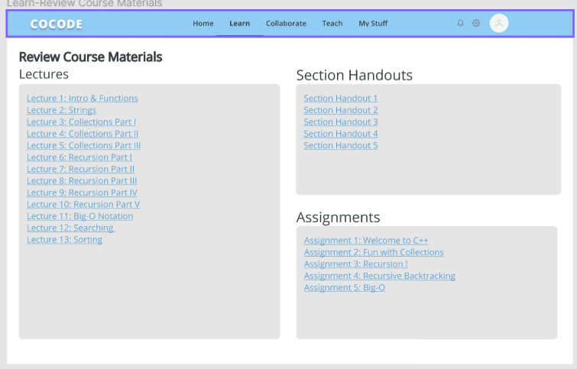
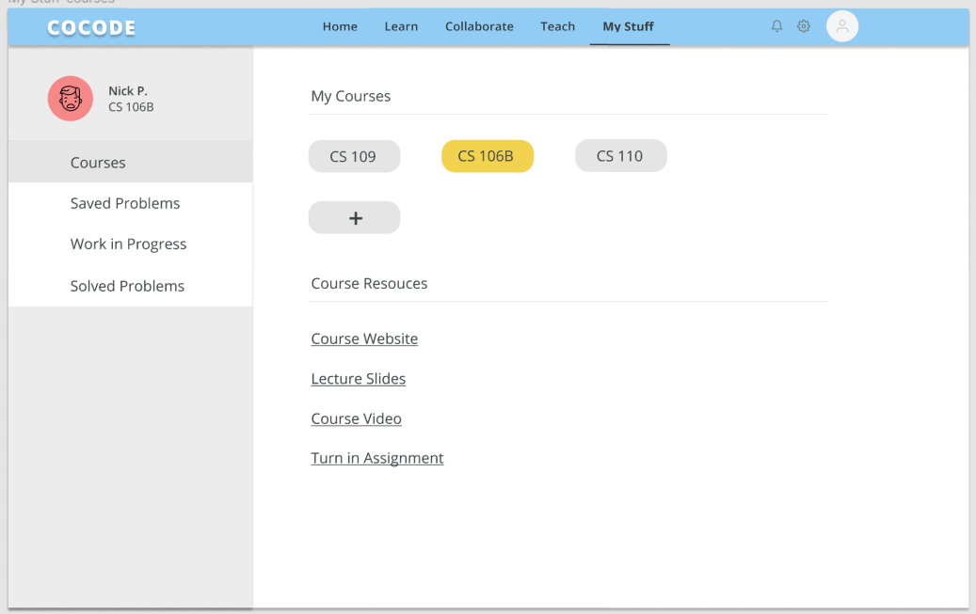
Revised: Course Material Review
Aggregated course material links under “learn” and “my stuff”

Slide 23
Revised: Course Material Review
Rationale:
On the learn tab, we added the functionality to choose to review lecture materials or learn from a peer tutor. We heard in our interviews that students want to try to clarify any misunderstandings on their own before they go to others for help. We also added this functionality when looking at a problem on the collaborate space.

Slide 24
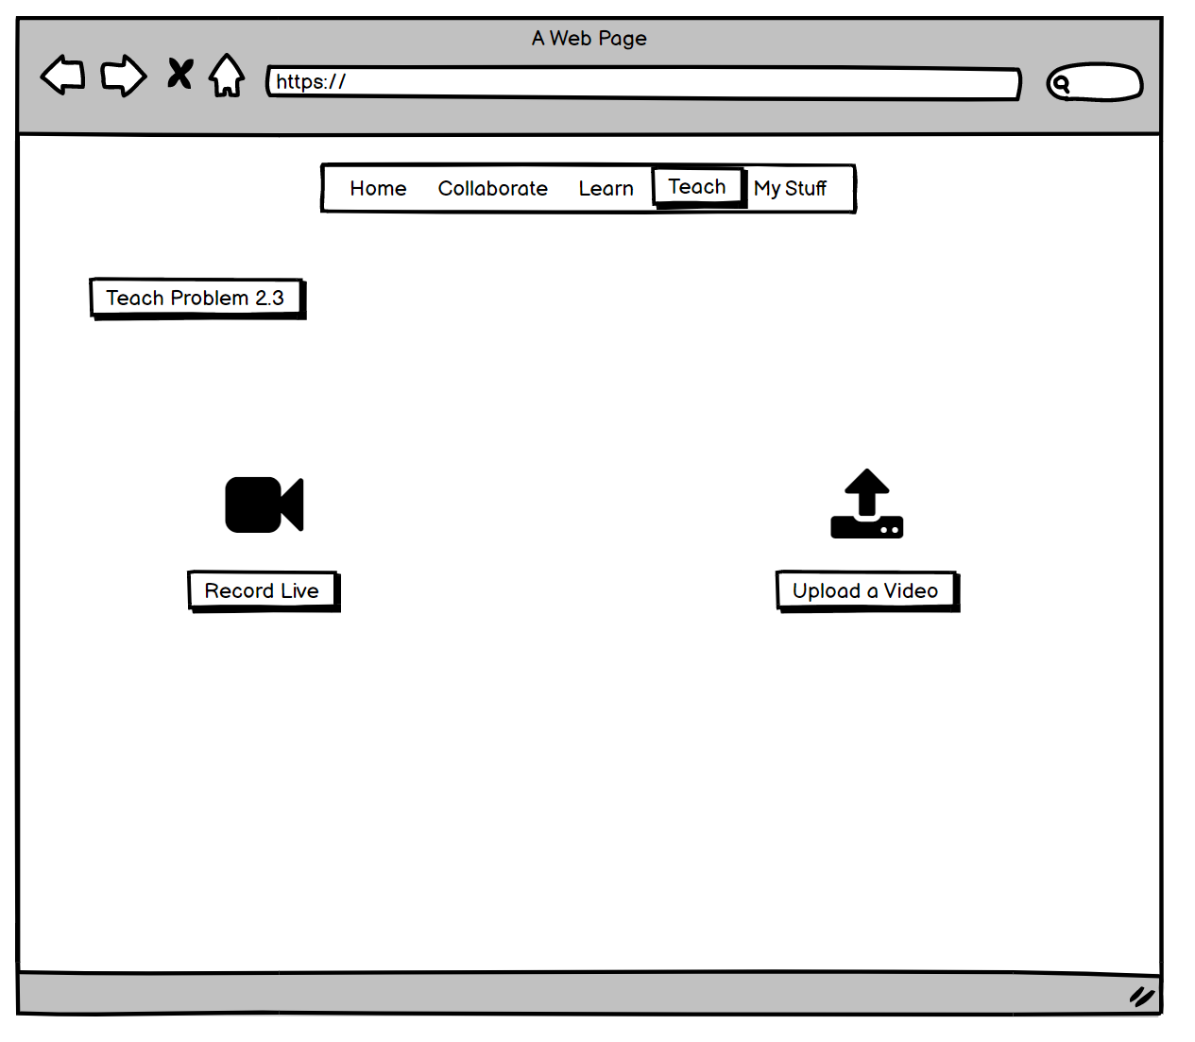
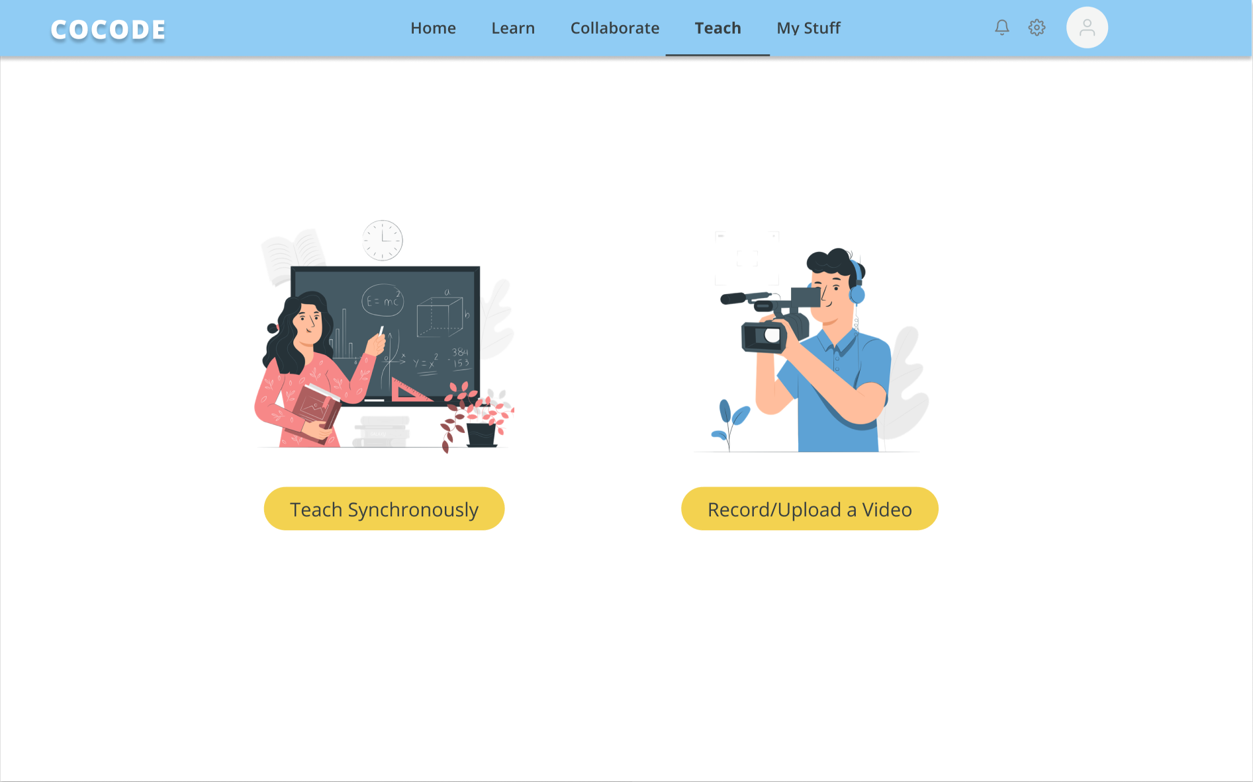
Revised: Teaching
Unclear how to do a synchronous session
Clear way to do a synchronous session

Slide 25
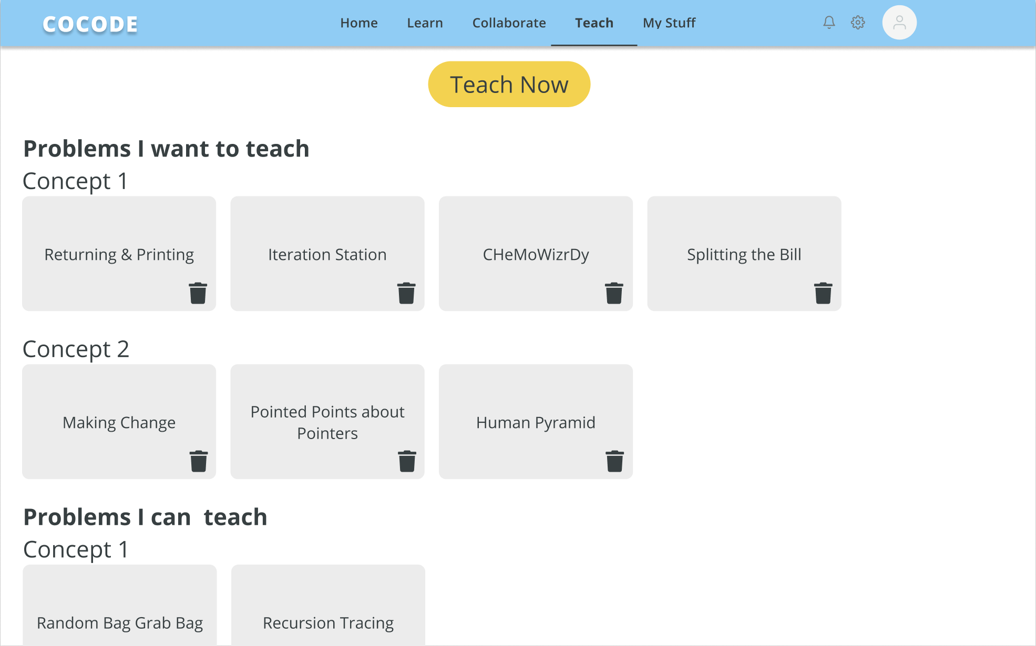
Revised: Teaching
Can sign up as available to teach multiple problems
Can only sign up to teach one problem

Slide 26
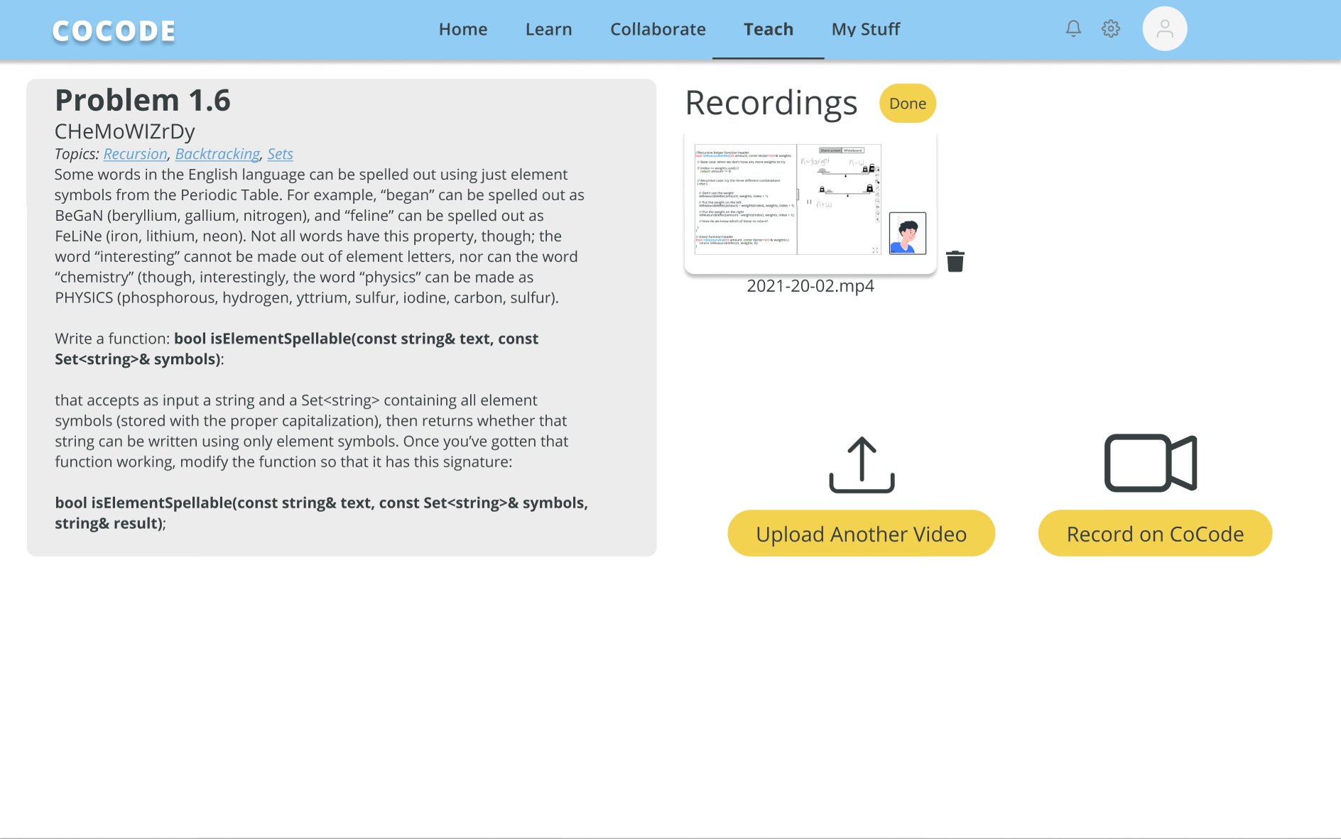
Revised: Teaching
Can only upload one video
Can upload and manage multiple videos for one problem

Slide 27
Revised: Teaching
Rationale:
We noticed confusion in the low-fi testing about how one would go about doing a synchronous teaching session. We also heard that it would be helpful to upload multiple videos for the same concept. Finally, we (and our participants) imagined that in classes with many problems, there may not always be someone interested in learning one particular problem.

Slide 28
Prototype Overview: Tools
We used Figma to create the medium-fi prototype
You can click through different buttons on our figma prototype to navigate through the screens
If you are on a page and click somewhere without a button, it will show you the available interactions on that page
Some clicks will bring you to new pages, some enter you into a collaborative space, and others allow you to save certain problems to your list of problems you want to learn or teach
Our inspiration sites are: Netflix and EdStem

Slide 29
Prototype Overview: Limitations
Do not have every choice of problem as functional
  On a given slide with problems, there is only one problem that you can choose to learn/collaborate/teach
In the learn tab, the whiteboard flow is on a timer as we do not have a functional whiteboard software yet
The filter in our search bar does not work to find open rooms to collaborate
We do not have the functionality to start a new problem with the same group that you are working with (whether that is as a collaborator, a teacher, or a student).
We also do not have a great system for scheduling a time to learn/teach that is not right at the time that you get the notification

Slide 30
Prototype Overview: Hardcoded
The class schedule on the first screen is hard coded (CS109, CS106B, CS110)
The specific class we prototyped is CS106B, so all content is from that course
We hardcoded the lecture materials that you can visit to review to only one lecture (lecture 4)
We hardcoded the problems that one is learning or teaching to be ismeasurable and chemowizardry respectively. The functionality should exist for all problems, but we only built the medium-fi for these two problems

Slide 31
What questions do you have?

Slide 32
Appendix

Slide 33
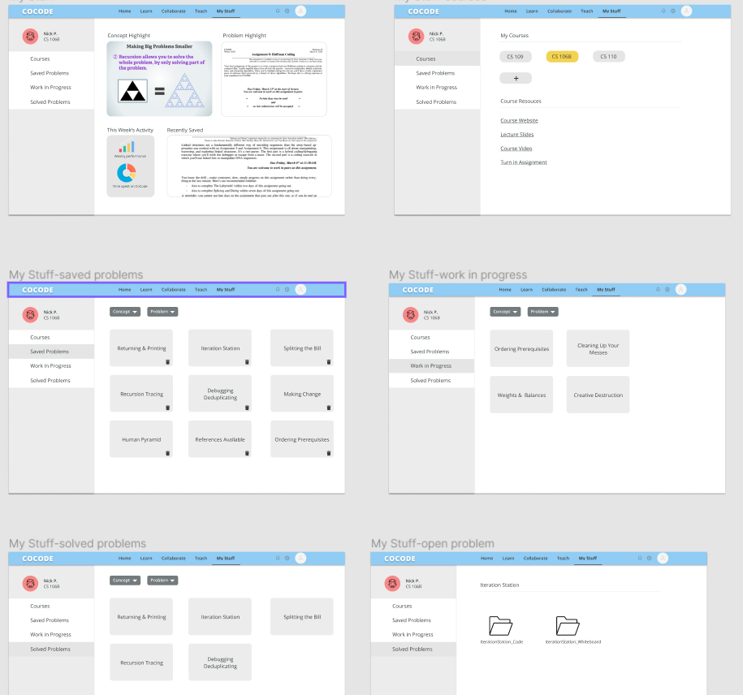
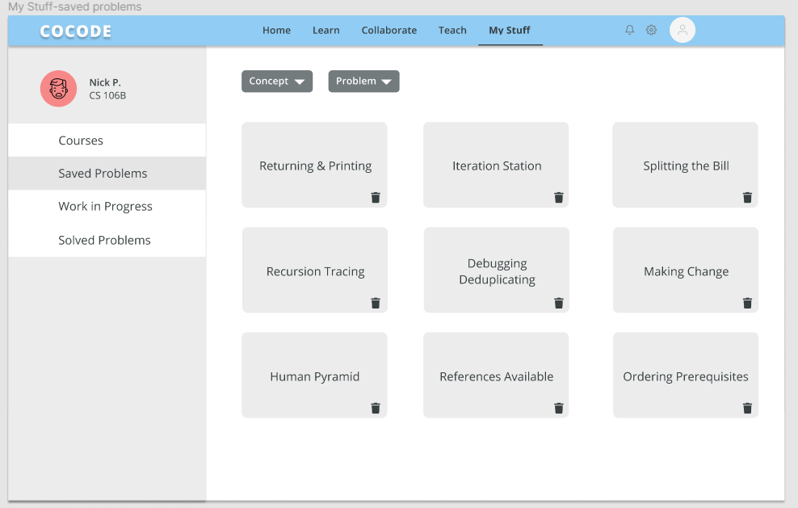
New “My Stuff” dashboard/portfolio

Slide 34
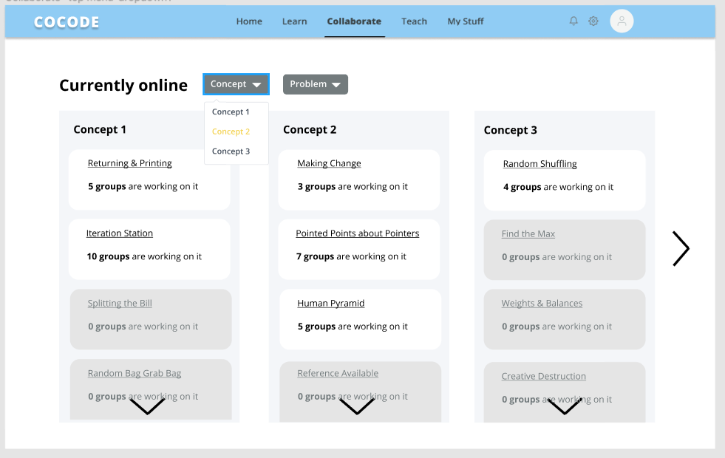
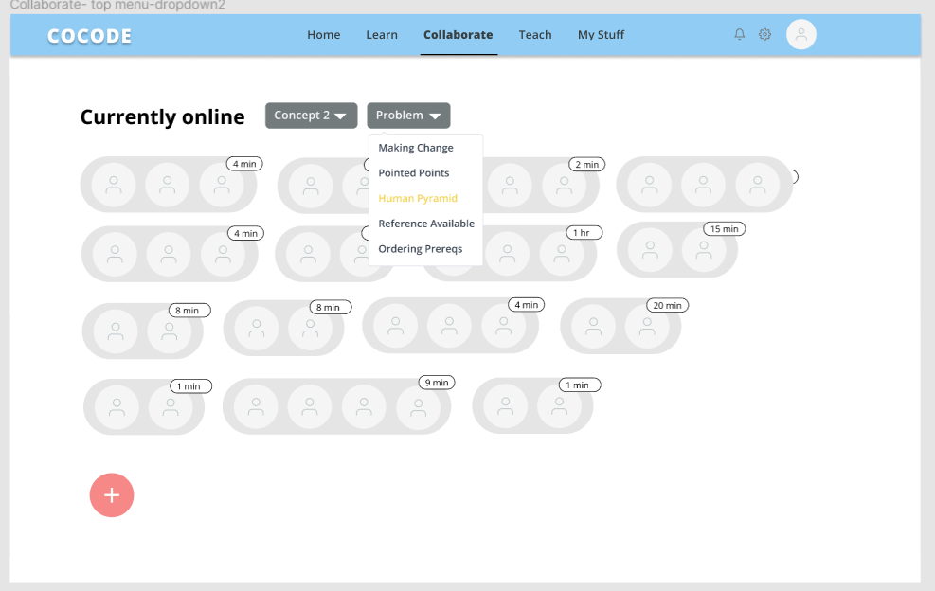
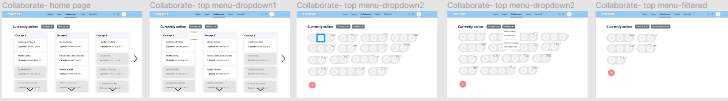
New group finder under collaborate

